Slide 1
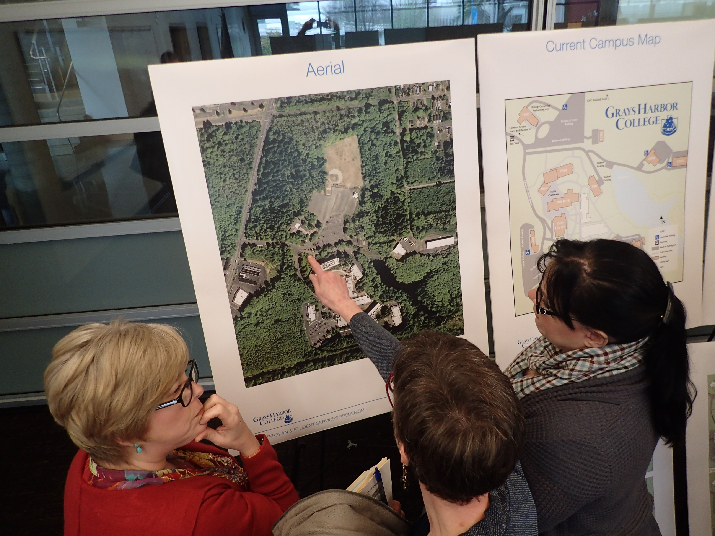
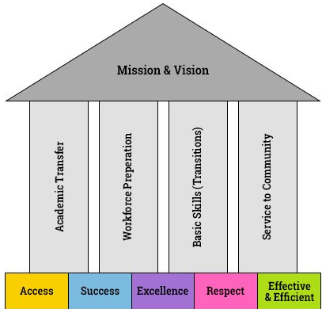
Masterplan Goals
^{Masterplan Components:}
  ^{Student Services Building}
  Student Rec / Health and Wellness
  ^{Student Housing}
  ^{Long House}
  ^{Parking / Campus Access}
  Potential Future Academic Buildings
The master plan should focus on the following:
  a) Creating a 21st century campus for education
  b) Creating a campus community connection for academics and student athletes.
  ^{c) Connection to community}
The College’s strategic plan is not finalized, so there is a need for the master plan to incorporate flexibility and adaptability.
Accessibility – pedestrian routes and building access
Welcoming / nonthreatening first point of contact for new students
Make steps toward resolving traffic, circulation, and parking issues
^{Additional access road}
^{Make existing entry road wider}
^{Plan for student housing}
^{Expand childcare center}
Add a 50-70 person black box theater to the Bishop Center
^{Diesel Technology Program}
Lake Swano Trail Amenity for joggers / hikers / community
Masterplan is a catalyst for the college to meet their Mission and Vision

Slide 2
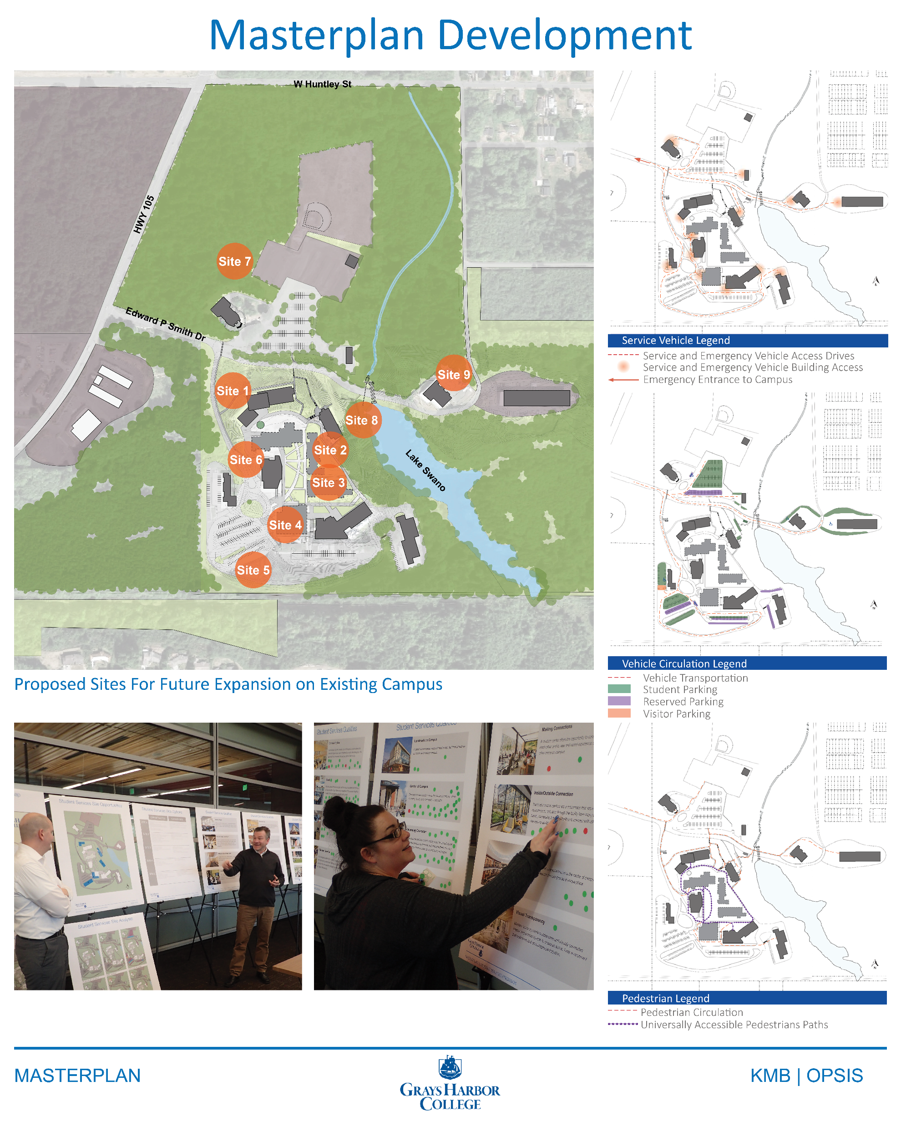

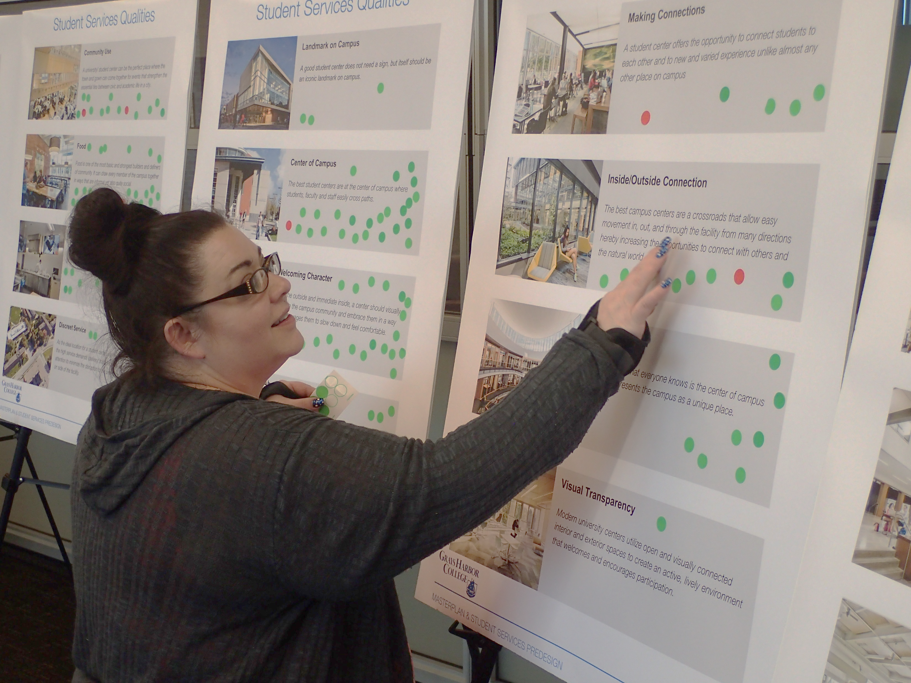
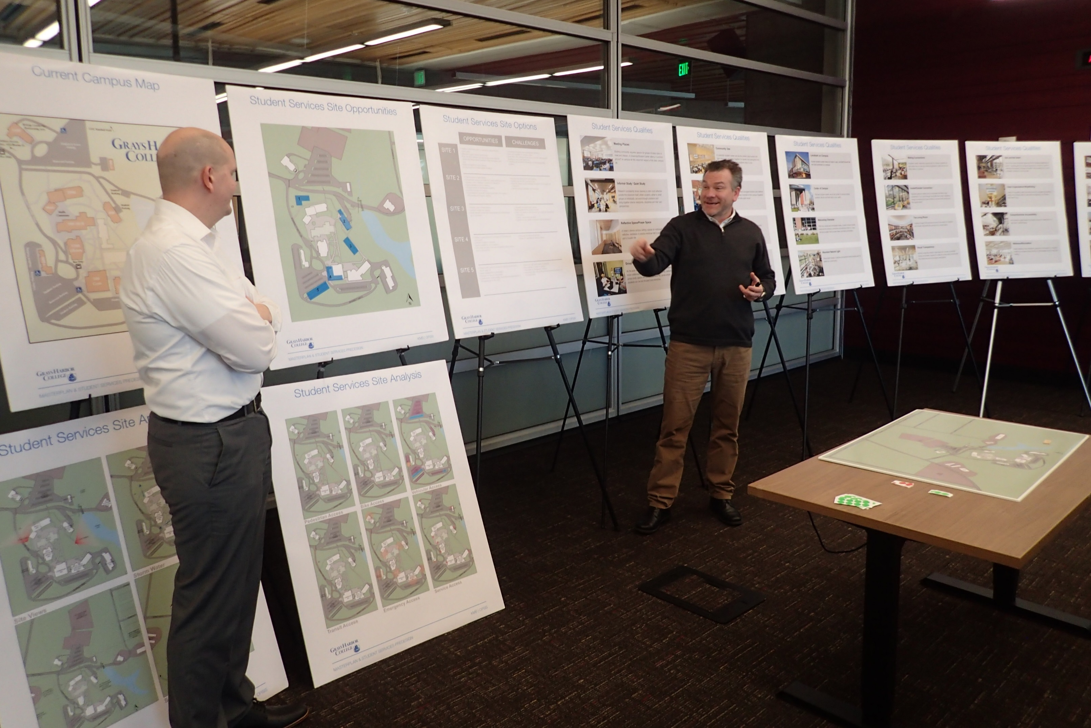
Masterplan Development

Slide 3
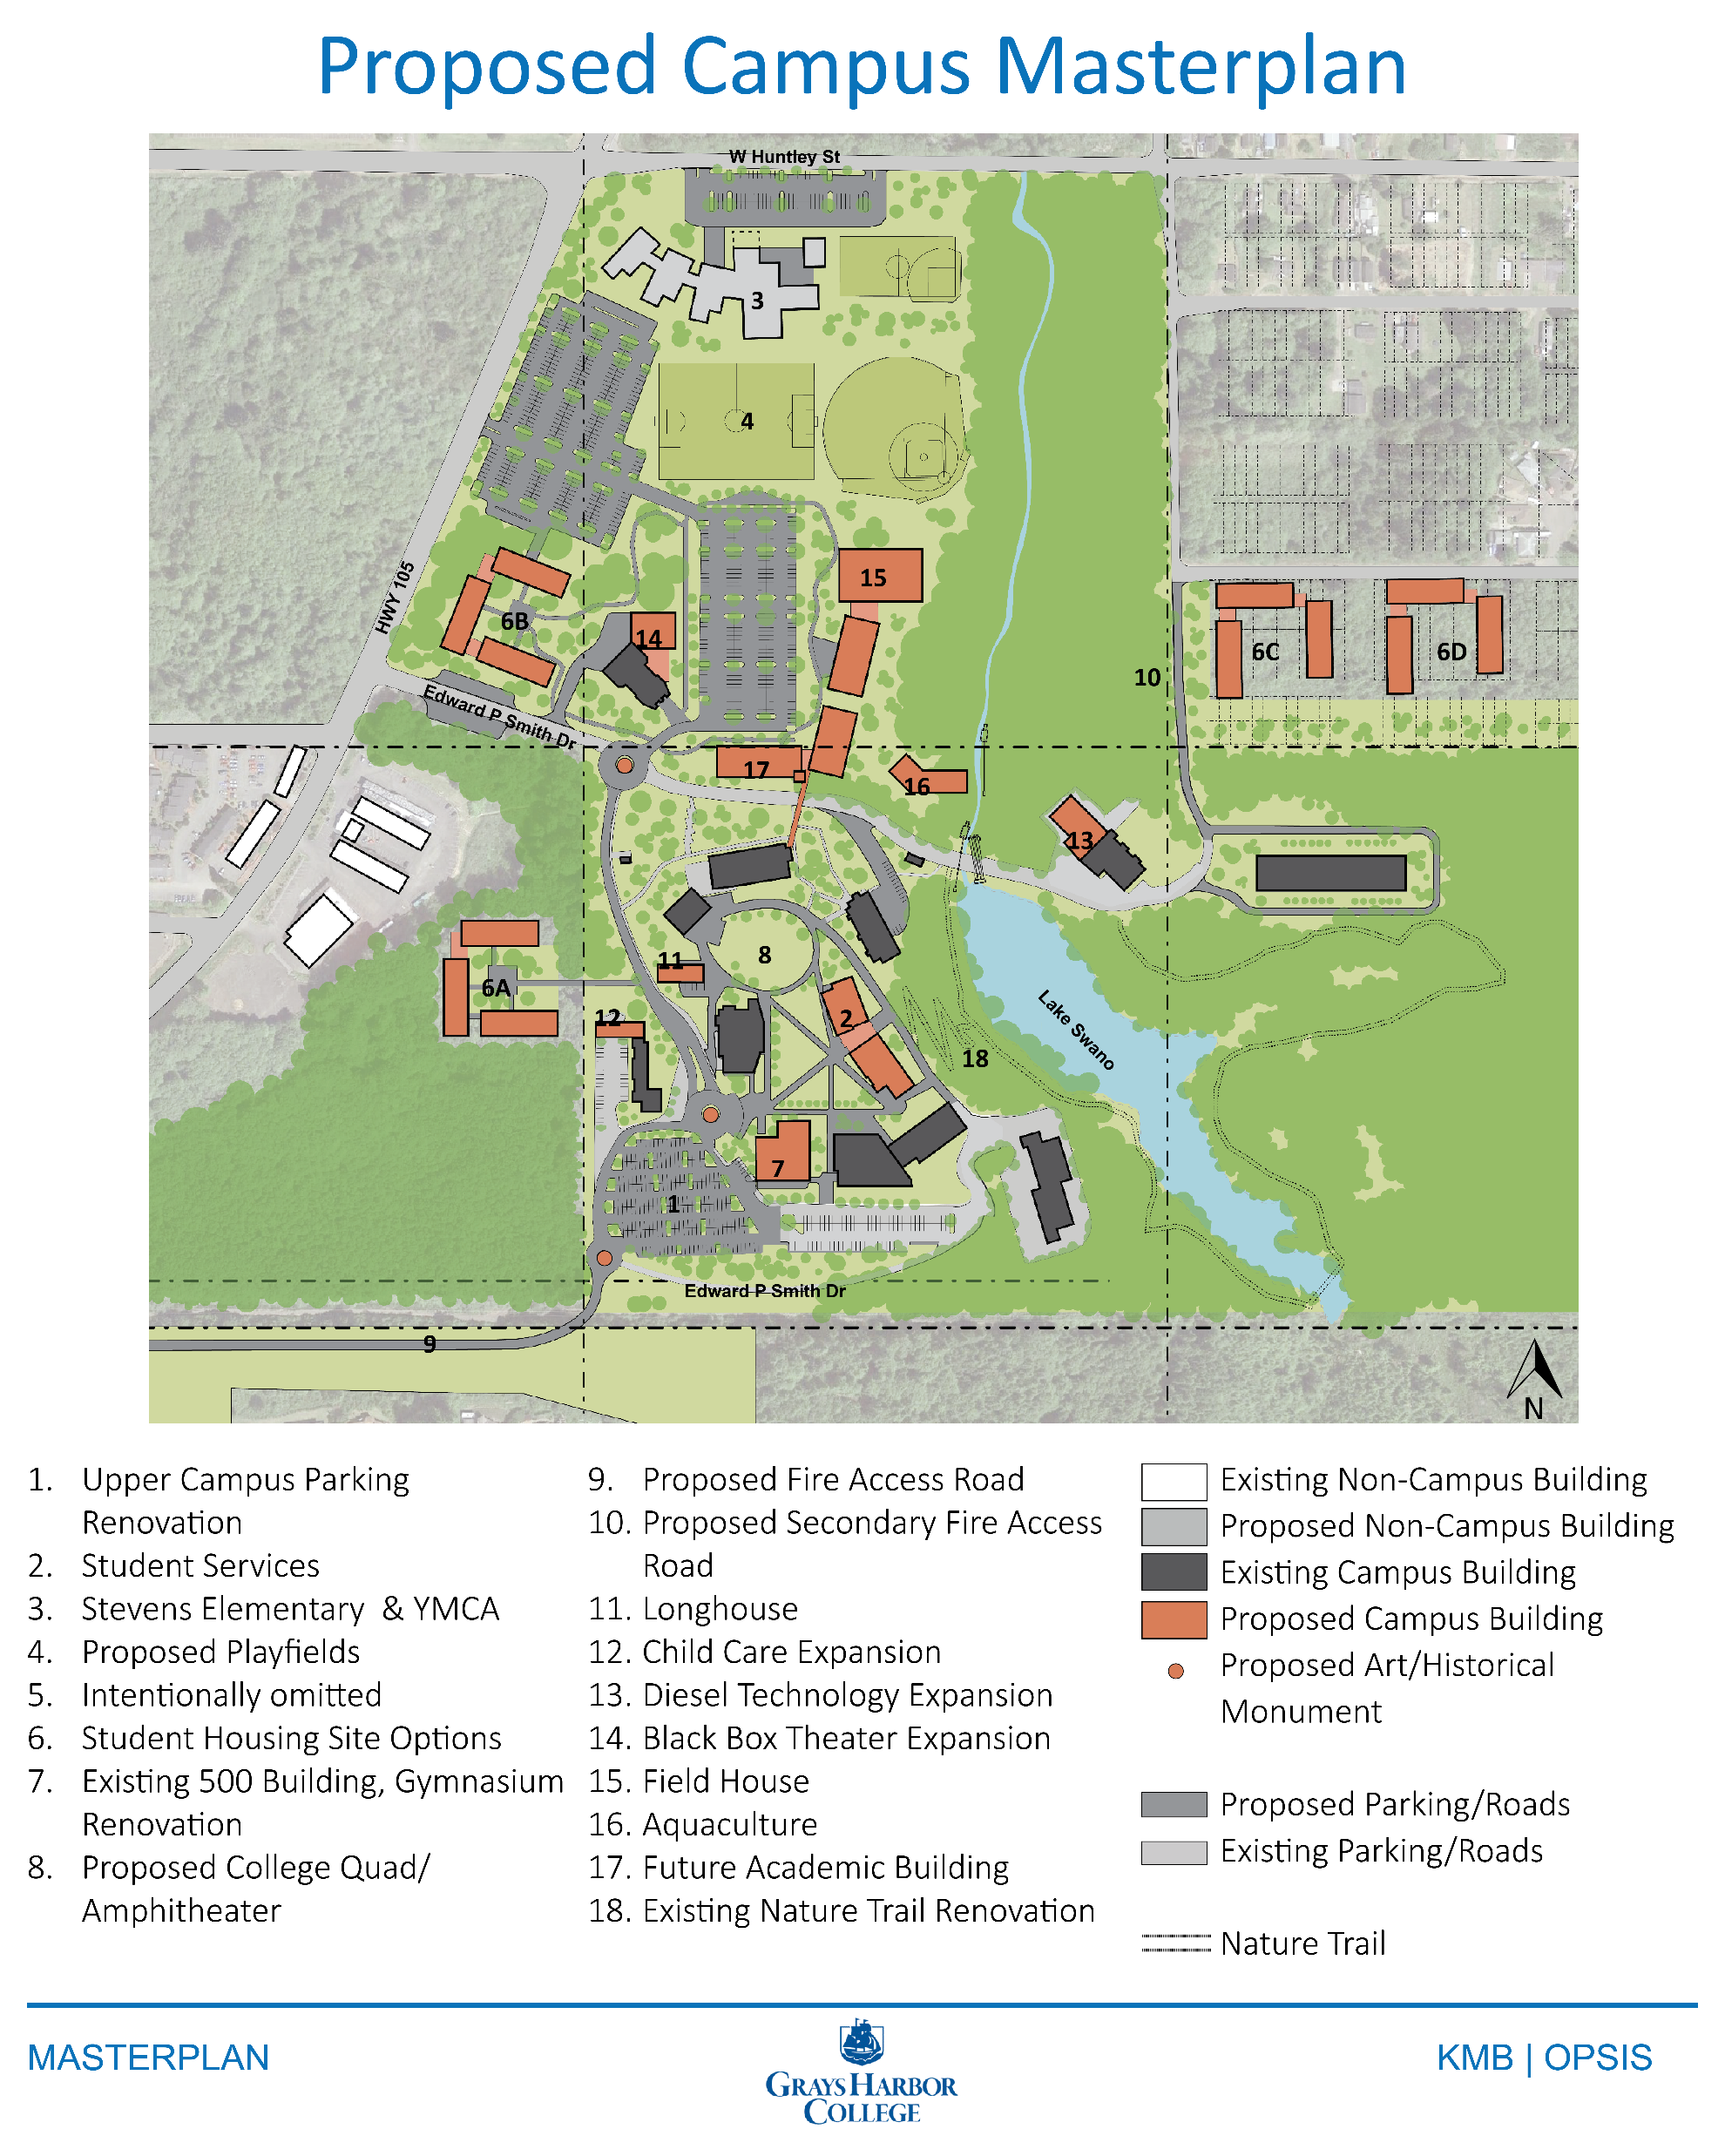
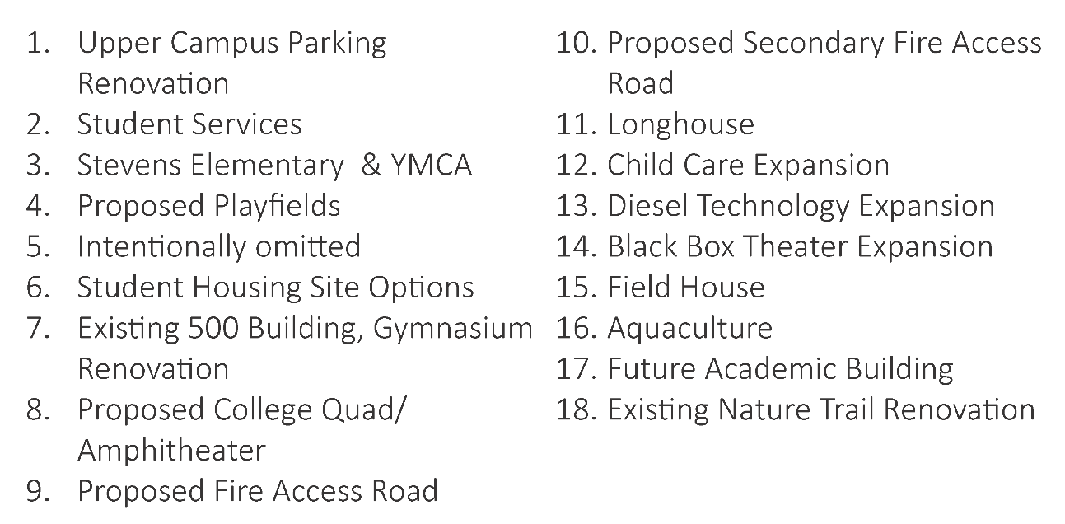
Proposed Campus Masterplan

Slide 4
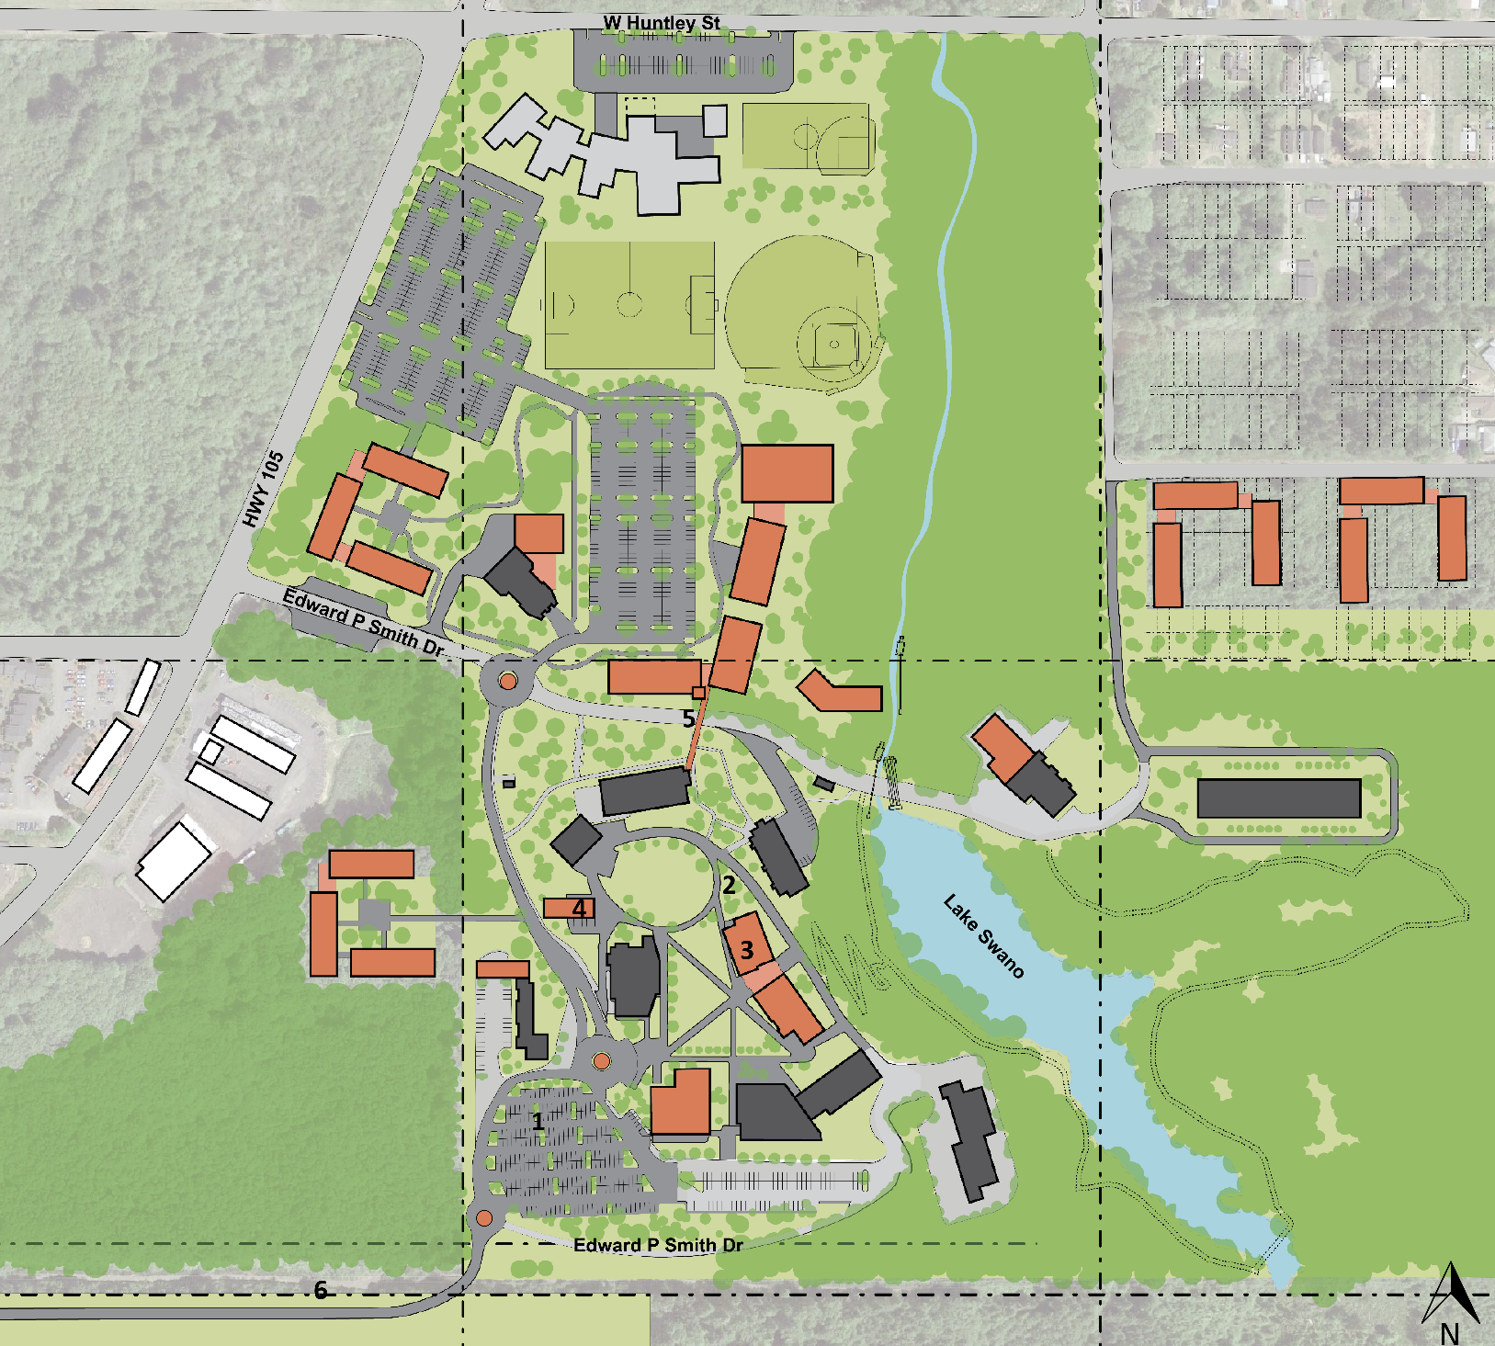
Proposed Accessibility Improvements
1. Reconfiguring Upper Campus Parking Lot
  The upper campus parking lot will be leveled and reconfigured to increase parking and improve handicap parking.
2. Development of an Upper Campus Access Road
  The addition of an access road that serves upper campus will improve facility service, handicap, and emergency access to buildings that are currently deemed inaccessible.
3. Student Services Building: Accessible Campus Corridor
  Campus buildings can be planned to accommodate campus traffic and accessibility. The proposed Student Services Building is located where there is a grade change among upper campus between the Schermer Building and Manspeaker.
4. Strategic Longhouse Location
  The proposed Longhouse location allows an increase in designated handicap parking stalls among upper campus and would connect to the proposed Upper Campus Access Road.
5. Footbridge between Manspeaker and Lower Campus
  The addition of a footbridge between the upper and lower campus will allow for improved foot traffic between upper and lower campus’s elevation grades.
^{6. Campus Access Road}
  The designation of an egress road that connects Grays Harbor College’s upper campus to Highway 105 creates an additional emergency exit and improves campus traffic circulation.

