Slide 1
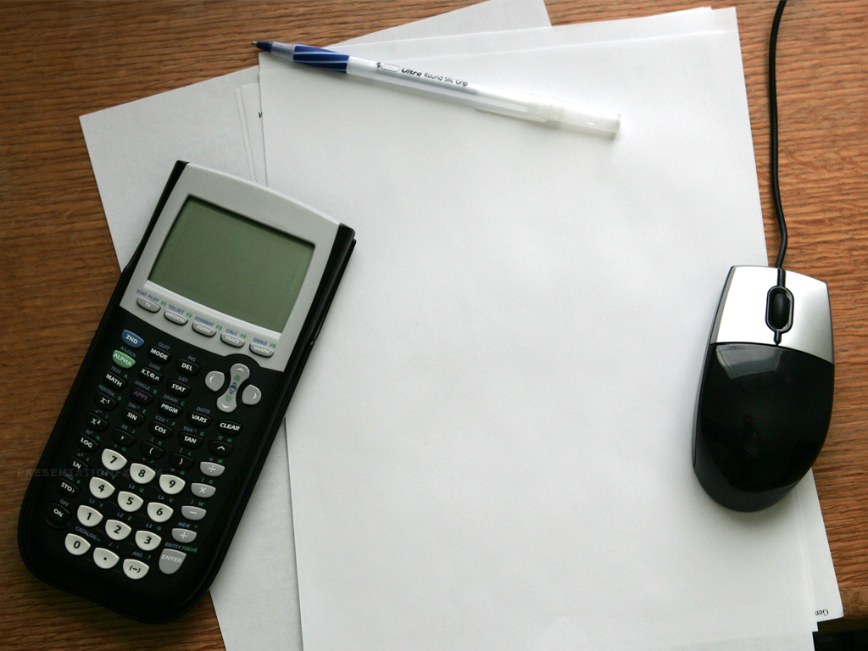
Succeed in
Math

Slide 2
What Would You Do
If you wanted to be a
successful…
Athlete? Dancer? Musician? Artist?
Would you…
Listen to a lecture?
Read a book?

Slide 3
Math is a Skill
Like athletics, music,
dancing, and art, math is
a skill
Skills must be learned and practiced
People take varying amounts of practice to get good at particular skills
Notes:
Some people can learn to play a song just by hearing it once. Someone else may need to practice for hours. One person may pick up a dance move easily. The next person may trip over their feet the first twenty times they try it. Some people learn math easily. Others have to work harder at it. With all of these skills, the more you learn, the easier you learn the next part.

Slide 4
Participate in Class
Sit near the front
Introduce yourself to other students
Review and Preview before class starts
Take good notes
  Write down everything the instructor
  writes on the board
Ask questions
Work at least a few problems right away after lecture

Slide 5
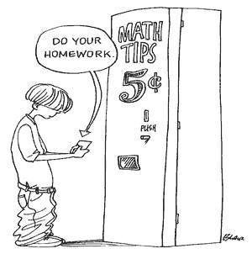
Homework
Work problems as soon as possible
after lecture
Do most recently assigned homework first
Write out each step. Use lots of paper

Slide 6
More About Homework
Work problems without
looking at the solution
Don’t stay stuck
  Create a model - a simpler, similar problem
  Write what you do know
  Research in your text or online
  Move on and come back to the problem
Work extra problems for
additional practice

Slide 7
More About Homework
Do your homework even if you understand the concepts
Do your homework even if you don’t understand the concepts. It may come to you after some practice.

Slide 8
Studying
Create cram cards
Make a practice test
Review previous tests and quizzes
Preview upcoming material
Review the basics
Notes:
Bring cram cards

Slide 9
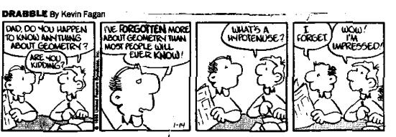
More About Studying
Teach concepts to
someone else
Annotate your notes
Read your text
Make a vocabulary and/or formula list

Slide 10
Study Cycle: Part 1
Class Preparation and Processing
  Preview material before class
  Go to class and participate actively
  Review and process notes
Notes:
How to study handout

Slide 11
Study Cycle: Part 2
50-Minute Study Sessions
  Set a GOAL for this session
  Study with FOCUS and ATTENTION
      No multi-tasking!
  Take a break
  Review previous session
  Repeat

Slide 12
“Story Problems”
Read the whole problem
What important data is given?
  Make a list
  Draw a picture of the situation
What is the question ?
  Read the whole problem again
  What is being asked?
How will you get the answer?
  Read the problem again
  Develop a plan
Carry out the plan
  “Do the math”
Ask yourself, “Does the answer
make sense?”

Slide 13
Math Resources
Your Instructor
Classmates
GHC Learning Center
eTutoring
  www.ghc.edu/etutoring
Notes:
Math resources handout
LC brochure

Slide 14
More Math Resources
Learning Links
  https://www.ghc.edu/instruction/learning-center/learning-links
Math Brush Ups
You Tube
Google

